Slide 1
QUEUES ALL THE
WAY DOWN
Tracing SQL Server I/O
Argenis Fernandez
Principal Architect

Slide 2

If you don’t know anything about how SQL Server works with storage, that’s totally OK. Watch this video:
https://www.youtube.com/watch?v=zcI1kytF-SM
And then read this blog post to reinforce:
https://blog.purestorage.com/what-is-sql-servers-io-block-size/

Slide 3

ABOUT ME
Yep, I’m a vendor and I work in Sales. Haters are gonna hate.
What does an Architect do again?
Former Data Platform MVP
Former vExpert
Former Principal PM @ Tiger
Former MCM?
More importantly, I’m an ally.

Slide 4
THE AGENDA
TRACING
TRACING
TRACING
TRACING
TRACING
Application (SQL SERVER!)
Guest OS
Hypervisor
Storage Network
Storage Device

Slide 5
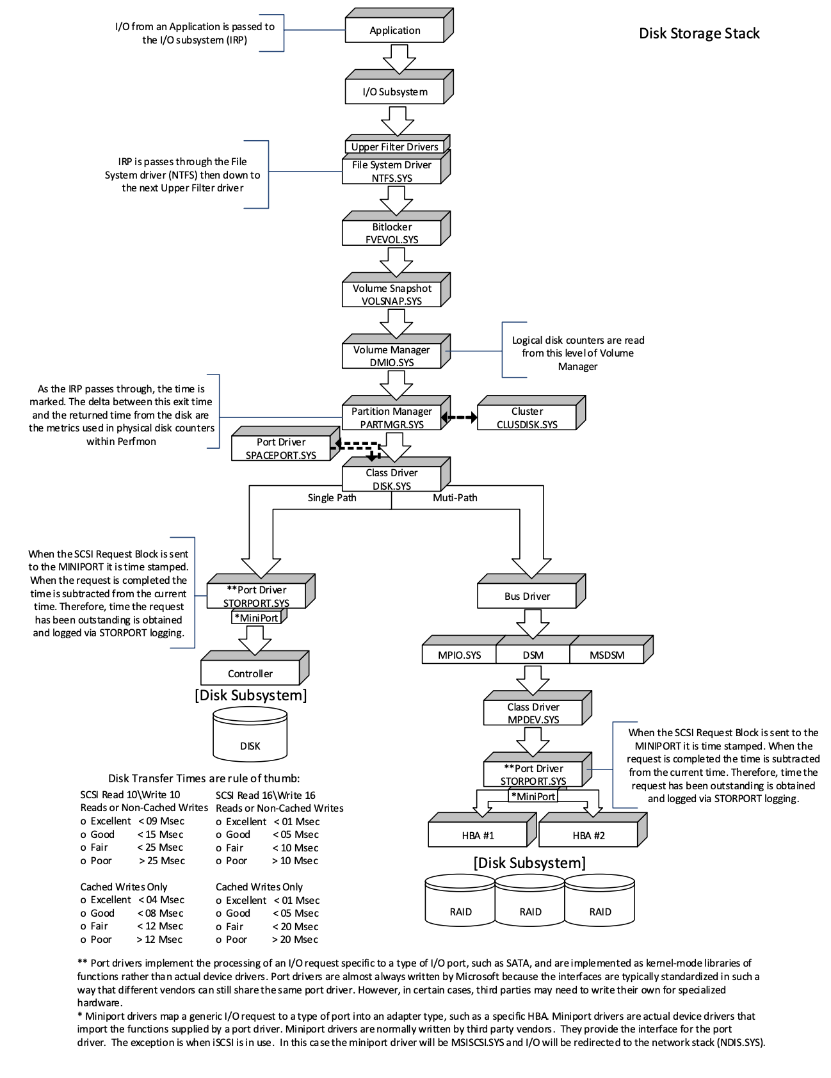

Slide 6
TRACING IN THE APPLICATION
SQL SeRVER

Slide 7
<WinDBG Demo Goes Here>

Slide 8
TRACING IN THE GUEST

Slide 9
ProcMon: https://docs.microsoft.com/en-us/sysinternals/downloads/procmon Storport tracing: https://wiki.webperfect.ch/index.php?title=trace:_storport_etw

Slide 10
TrACING THE HypERVISOR?

Slide 11
ESXTOP for VMware: https://kb.Vmware.Com/s/article/1008205 vScsiStats: https://cormachogan.com/2013/07/10/getting-started-with-vscsistats/

Slide 12
TRACING THE STORAGE NETWORK

Slide 13
We didn’t get to this. LOOK FOR A FOLLOW UP SESSION SOON.

Slide 14
TRACING THE STORAGE DEVICE ITSELF

Slide 15
We didn’t get to this. LOOK FOR A FOLLOW UP SESSION SOON.

Slide 16
THANKS TO
Cody Hosterman (Pure Storage)
Arvind Shyamsundar (Microsoft)
Alessandro Goncalves (Intel)
Erin Stellato (SQLSkils)
Jonathan Kehayias (SQLSkills)

